Slide 1
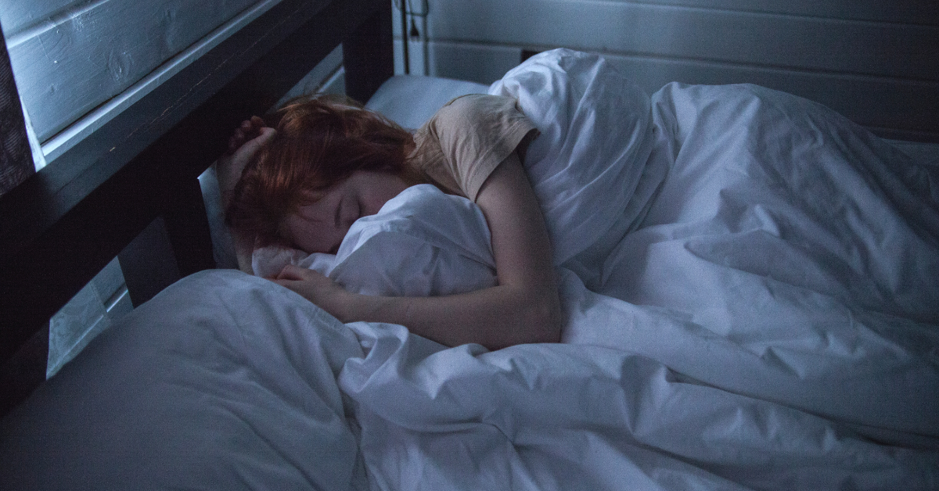
IMPACT OF LIFESTYLE ON SLEEP HEALTH
BY: AJAY PATIL

Slide 2
PROBLEM STATEMENT
The Sleep Health and Lifestyle Dataset covering a wide range of variables related to sleep and daily habits.
It includes details such as gender, age, occupation, sleep duration, quality of sleep, physical activity level, stress levels, BMI category, blood pressure, heart rate, daily steps, and the presence or absence of sleep disorders.

Slide 3

OBJECTIVE
machine learning model to predict sleep disorders based on lifestyle factors . By understanding the factors that affect sleep quality, we can develop interventions to improve sleep quality and reduce the risk of sleep disorders.

Slide 4
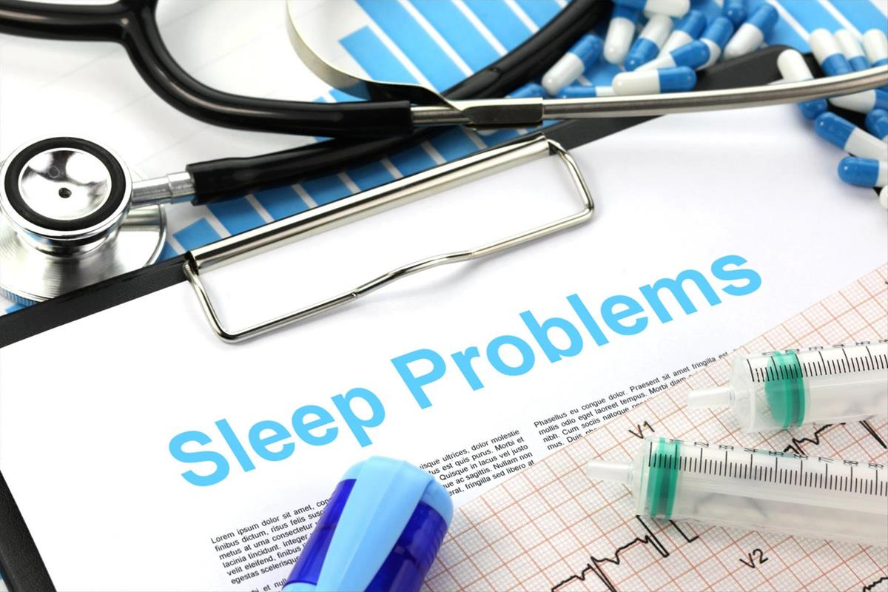
What is sleep disorder?
Affect the ability of individual to sleep well.
Men as well as women face this type of difficulty
Due to various factors like stress ,work load ,bp.
Insomnia,sleep apnea

Slide 5
DATA DEFINATION
Person ID: An identifier for each individual.Gender: The gender of the person (Male/Female).
Age: The age of the person in years.
Occupation: The occupation or profession of the person.
Sleep Duration (hours): The number of hours the person sleeps per day.
Quality of Sleep (scale: 1-10): A subjective rating of the quality of sleep, ranging from 1 to 10.

Slide 6
BMI CATEGORY: The BMI category of the person (e.g., Underweight, Normal, Overweight)
Blood Pressure (systolic/diastolic): The blood pressure measurement of the person, indicated as systolic pressure over diastolic pressure.
Heart Rate (bpm): The resting heart rate of the person in beats per minute. Daily Steps: The number of steps the person takes per day.
Sleep Disorder: The presence or absence of a sleep disorder in the person (None, Insomnia, Sleep Apnea).

Slide 7
DETAILS OF VARIABLE
None: The individual does not exhibit any specific sleep disorder.
Insomnia: The individual experiences difficulty falling asleep or staying asleep, leading to inadequate or poor-quality sleep.
Sleep Apnea: The individual suffers from pauses in breathing during sleep, resulting in disrupted sleep patterns and potential health risks

Slide 8
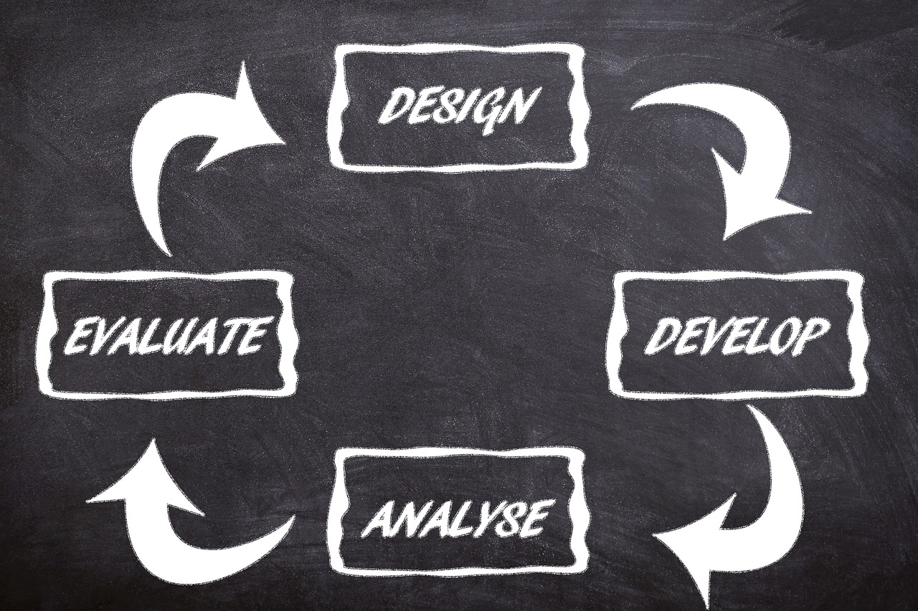
STEPS
DEFINING THE PROBLEM
DATA GATHERING AND DATA CLEANING
DATA PREPARING
ML ALGORITHM
TRAIN THE MODEL
EVALUATING THE MODEL

Slide 9
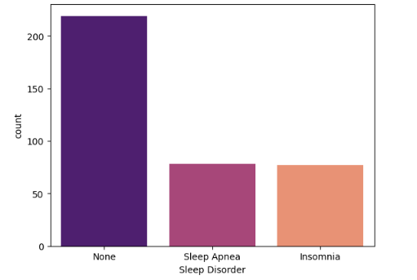
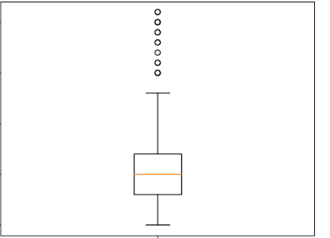
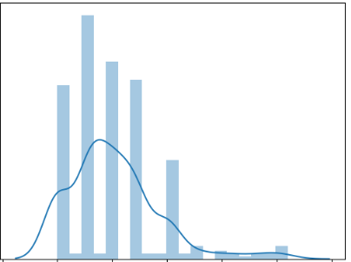
EDA(Exploratory data analysis)
Understanding the variables
Cleaning the data
Visualization of data
Analyzing relation between varible
Count plot ,box plot ,distribution plot,scatter plot,heat map

Slide 10
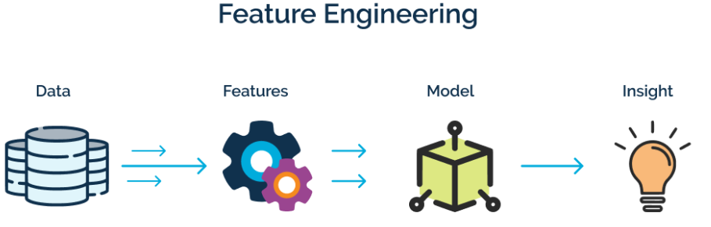
Feature Engineering
FEATURE SCALING
ENCODING
BALANCING TARGET VARIABLE

Slide 11
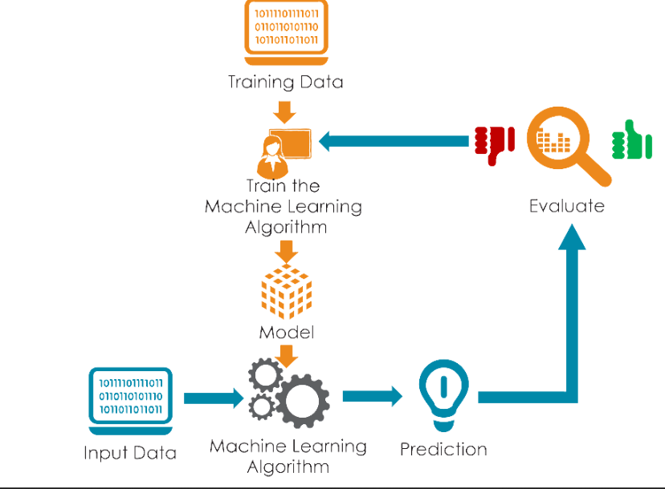
Model Building

Slide 12
steps
Clean data (eda feature engg)
Split data (x,y)
Imbalnced data (SMOTETomek)
Robustscaling
Apply different ml models and check accuracy
Performance matrix
Hyperparameter tunning

Slide 13

Model Evaluation
Confusion matrix
Accuracy
Precision
Sensitivity
Recall
Roc
Auc
Specificity

Slide 14
HYPERPARAMETER TUNNING
Hyperparameters are the parameters that are explicitly defined to control the learning process before applying a machine-learning algorithm to a dataset. These are used to specify the learning capacity and complexity of the model.
GRIDSEATCHCV
RANDOMNIZEDCV

Slide 15
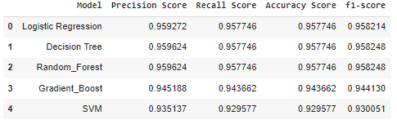
RESULT

Slide 16
CONCLUSION
The proposed ML project has the potential to make a significant contribution to the prevention and treatment of sleep disorders. The project will provide valuable insights into the role of lifestyle factors in sleep disorders and will help to develop more effective interventions for these conditions.

Slide 17


